Slide 1
PROCUREMENT MANAGEMENT
Ninad Killedar (12775008)

Slide 2
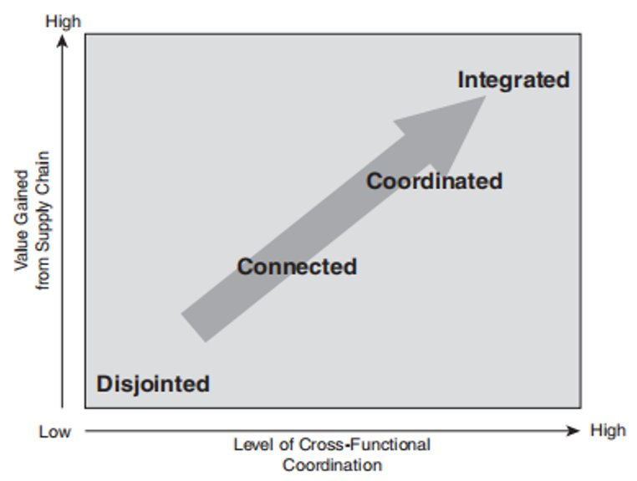
GROUP 19 Aqib Satar (8981024), Ninad (12775008), Vineesh Remiji (13181305)
and Tata Hariprasath (12038589)
HORSE MEAT SCANDAL
PROBLEM STATEMENT
This scandal arised from a DNA test on horse meat conducted by Tesco, found 29% horse in their Tesco branded beef burgers made by a meat processing supplier based in Ireland (O'Brien, 2014).
A third tier dutch meat procesor was accused of processing old rotten beef and horse meat which eneded up in tescos first tier meat processing supplier in Europe (ABP Food Group). (O'Brien, 2014)
This was a cost saving methoid used by suppliers, as investigations have shown “hourse hide” is one of the cheapest sources of additional protien sources and preservatives in so-called cheap economy ranged beef burgers.
Tesco CFTs [R A C I ]​ | Category Manager ​ ​ | SRM​ ​ | Project Manager​ ​ | Senior Management​ | CPO ​ | Purchasing Team​ ​ | Consultants​ ​
Sales Optimization ​ | R​ | I​ | I​ | A​ | I​ | C​ | I​
Effective control over the entire purchasing process​ | C​ | I​ | I​ | I​ | R​ | C​ | I​
Coordinating with and managing functional departments​ | C​ | C​ | R​ | A​ | C​ | C​ | I​
Supplier segmentation and performance improvement​ | I​ | R​ | I​ | A​ | R​ | C​ | C​
Negotiation of prices​ | I​ | C​ | I​ | I​ | A​ | R​ | I​
Informing stakeholders and defining KPIs​ | I​ | I​ | A​ | C​ | I​ | I​ | I​
Educating over category management concept ​ | I​ | I​ | I​ | I​ | I​ | I​ | R​
Vertical Integration
Backward integration by aquring wholesaler or distributor. Exp: COSTCO
Supply chain transperancy
Reduced inventories and improved customer satisfaction
Rationalization of supply base
Selection of limited strategic suppliers for tesco
Strong supplier-TESCO relationship
Single Sourcing
One supplier for each category of products
Simple and stable supply chain
Better quality of product
Vertical integration of supply chain can :
1)Proactive approach of accessing information from customers to accurately plan and forecast demand and inventory level. (Guan & Rehme, 2012)
2)Prevent sub-optimization (Karolefski & Heller, 2006)
TESCO
Renegotiation of existing deals
Proactive approach to improving and developing benefit for both parties i.e “win-win” relationships
SRM Programmes
Analyzing supplier portfolio against future outcomes to be met
Supplier performance improvement
Make Continious Improvements
Applying category management to each different category of product
Fig.1 Category Maturity Matrix (STAGE 1 Initiation) (Cordell et al., 2018)
Rationalization of the supply base help achieve the right number of suppliers who can deliver world-class performance (Monczka et al., 1995)
BUYER SUPPLIER RELATIONSHIP FOR TESCO
Stage 1 begins with a vital set of preliminary tasks and the analysis of the category utilizing best practices for project management. (Cordell et al., 2018)​
WIN/LOOSE
LOST/LOST
RACI is a way of mapping out 'who does what' in relation to a category project.(Cordell et al., 2018)​
Fig 2. Flowchart showing category strategy plan for tesco (Cordell et al., 2018)
Source adapted from : (Thomas et al., 2018)
Tesco can implement new regulations, audits and test certifications that need to be in place before goods reaching Tesco rules for specific categories of products made from livestock.
A network can help Tesco eliminate the issue of traceability and provide transparency. (Christopher , 2005)
Tesco can have a collaborative development with Tier 1 suppliers in ensuring quality standards, mitigating risks and identify where and how they can save costs. (Christopher , 2005)
Value Creation
Risk Analysis
Cost
1) Finding new suppliers (Aastrup et al., 2007).
2) Promotions (Aastrup et al., 2007).
3) Pricing (Aastrup et al., 2007).
Single Sourcing
1) Tesco can develop a long-term relationship with the supplier (Costantino & Pellegrino, 2010).
2) Tesco can get more consistent quality (Costantino & Pellegrino, 2010).
3) It will be easier for Tesco to identify the issues' root causes (Costantino & Pellegrino, 2010).
4) Reduce purchase price for Tesco resulting from reduced production cost (Costantino & Pellegrino, 2010).
Price and Quality were the main goals to Tesco.
Tesco were mainly concered about their profitability outcome without consideration the benfits of the other party. : (Thomas et al., 2018)
This led their suppliers using illigal processing methods to meet their expectations which makes them both to loose.
Reactive purchasing.
1) Customer’s trust in TESCO plummeted (Smith & McElwee, 2021).
2) Loss of TESCO’s reputation (Smith & McElwee, 2021).
3) Huge loss in sales for TESCO (Simon Neville, 2013).
Profit impact is considered high within this specific category.
Processed Beef has an abundant supply therefore supply risk may not be as high.
Teco has the full purchasing power and cost savings can be made due to higher volumes.
New Rules and Regulation
Multi Sourcing
1) Supplier commitment was very low (Costantino & Pellegrino, 2010).
2) Tesco faced quality issues from the suppliers (Costantino & Pellegrino, 2010).
3)Higher purchasing cost for Tesco (Costantino & Pellegrino, 2010).
RISK
Information Flow
2) Huge financial loss for TESCO (Smith & McElwee, 2021)
Leverage Items
(Beef)
McAdam Foods
(Netherlands)
SILVERCREST FOODS
(IRELAND)
ABP FOOD GROUP
Tesco
Goods Flow
(fig. inspired from Sandy Buckinx’s slides on category management)
Audits
Industrial Standards Certifications
PRACTICAL ISSUES
RECCOMENDATIONS
PROFIT IMPACT
Source adapted from: (Christopher , 2005)
DNA Tests
Inflation – rising prices of fast moving consumer goods.
Highly regulated beef industry.
High demand for low ranged products in the UK.
Hiring a category manager.
Establish processes and goals for future supplier
development.
EDI Approach to establish a direct relationship between Tesco and its suppliers, linked via electronic data interchange.
(Monczka et al., 1995)
Leverage | Nuisance | Development
 | Tesco have had a relationship mismatch. The most suitable stategy would be to look for an alternative supplier. (Weele, 2014) Production is at a high risk. (Weele, 2014) | Tesco can source new suppliers in which they can closly manage. (Weele, 2014) Better quality for better price. Cost saving strategies can be identified (Weele, 2014).
Development
Core
ACCOUNT
ATTRACTIVENESS
To be able to understand the type of product they are tying to source in relation to risk and profit using khraljic.
Understand the supplier preference after this scandal and analyse a business strategy using the Dutch Windmill to determine a competitive strategy to develop their suppliers.
Analyse how a supply chain network can provide tractability and transparency within the supply chain.
A relationship between CFT and of value gained from supply chain.
Analysis how vertical integration can be used as a strategy development tool for Tesco.
How single sourcing can ensure a better quality, price and relationship between Tesco and its suppliers.
Nuisance
Exploitable
KLP’S
Source adapted from : (Cordell & Thompson, 2018)
COMPETETIVE POSITION

Slide 3
REFERENCES
Aastrup, J., Grant, D. B., & Bjerre, M. (2007). Value creation and category management through retailer–supplier relationships. The International Review of Retail, Distribution and Consumer Research, 17(5), 523-541. https://doi.org/10.1080/09593960701632019
Christopher , M. (2005). Logistics, the supply chain and the competitive strategy . In Logistics and supply chain management: Creating Value-Added Networks (pp. 5–10). essay, FT Prentice Hall.
Cordell, A. and Thompson, I. (2018) in The Category Management Handbook. London: Routledge, pp. 1–27.
Cordell, A. and Thompson, I. (2018) in The Category Management Handbook. London: Routledge, pp. 85–113.
Cordell, A., & Thompson, I. (2018). STAGE 3 ANALYSIS. In The Category Management Handbook (pp. 60–70). essay, Routledge.
Costantino, N., & Pellegrino, R. (2010). Choosing between single and multiple sourcing based on supplier default risk: A real options approach. Journal of Purchasing and Supply Management, 16(1), 27-40.
David B. Grant. (2012). Logistics Management (1st ed.). Pearson education.
Guan, W. and Rehme, J. (2012) “Vertical Integration in supply chains: Driving Forces and consequences for a manufacturer's downstream integration,” Supply Chain Management: An International Journal, 17(2), pp. 187–201. Available at: https://doi.org/10.1108/13598541211212915.
Helms, M. M., & Nixon, J. (2010). Exploring SWOT analysis – where are we now? Journal of Strategy and Management, 3(3), 215-251.
Karolefski, J. and Heller, A. (2006) in Consumer-centric category management: How to increase profits by managing categories based on consumer needs. Hoboken, NJ: J. Wiley, p. 313.
Monczka, R.M. and Trent, R.J. (1995) in Purchasing and sourcing strategy trends and implications. Tempe, Ariz: Center for Advanced Purchasing Studies, pp. 44–54.
Monczka, R.M. and Trent, R.J. (1995) in Purchasing and sourcing strategy trends and implications. Tempe, Ariz: Center for Advanced Purchasing Studies.
O'Brien, J. (2014). In Supplier relationship management: Unlocking the hidden value in your supply base (pp. 9–11). essay, Kogan Page.
Simon Neville. (2013, February 26). Frozen burger sales plunge 43% after horsemeat scandal. the Guardian. https://www.theguardian.com/uk/2013/feb/26/frozen-burger-sales-fall-horsemeat-scandal
Smith, R., & McElwee, G. (2021). The “horse-meat” scandal: Illegal activity in the food supply chain. Supply Chain Management: An International Journal, 26(5), 565-578. https://doi.org/10.1108/scm-08-2019-0292
Thomas, S., Eastman, J., Shepherd, C. D., & Denton, L. T. (2018). A comparative assessment of win-win and win-lose negotiation strategy use on supply chain relational outcomes. The International Journal of Logistics Management, 29(1), 191–215. https://doi.org/10.1108/ijlm-10-2016-0238
Valentin, E. K. (2001). Swot analysis from a resource-based view. Journal of Marketing Theory and Practice, 9(2), 54-69.
van, W. A. J. (2014). Purchasing and Business Strategy . In Purchasing et supply chain management: Analysis, Strategy, Planning and Practice (pp. 169–175). essay, Cengage Learning.

